Slide 1

Recommendation System using PySpark
Peeyush Dyavarashetty

Slide 2

Problem Statement
Prediction version:
$N$ users and $M$ movies
Complete $M×N$ matrix
Ranking version:
Provide top-k items for user
Methods:
Content-based filtering
User’s past history
Collaborative filtering
User-user comparison
Movie-movie comparison
Latent factor methods
User\Item | 1 | 2 | 3 | 4 | 5
1 |  |  |  | 4.0 | 1.0
2
3 | 3.5 | 4.0 | 4.0 | 5.0
4
5 |  | 4.0

Slide 3
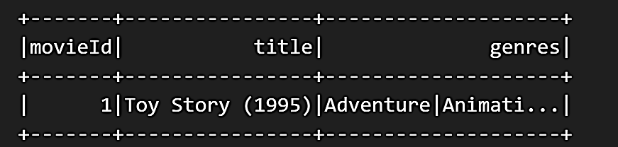
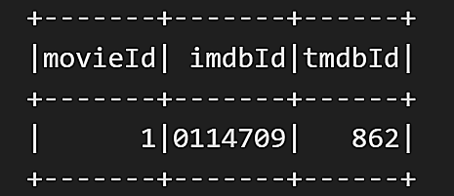
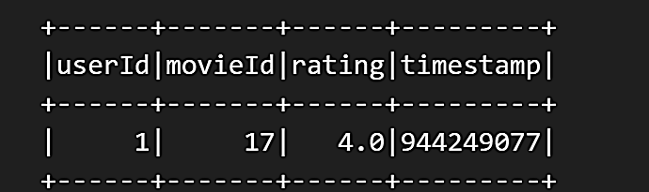
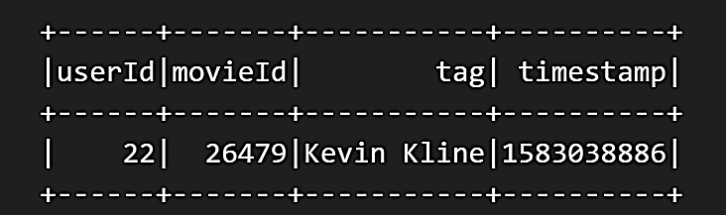
Data
Movies
Links
Movielens
32M ratings
200k users
87k movies
239MB
0.18% filled
Contains 4 csv files
Ratings
Tags

Slide 4
Data Exploration

Slide 5
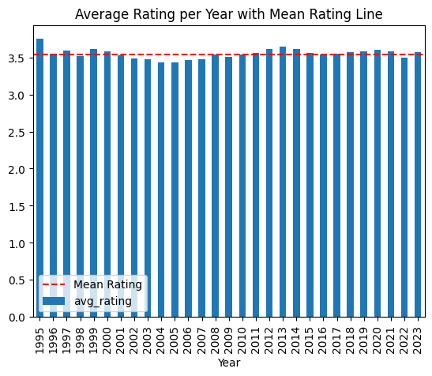
Data Split – Time based or Random?
Rating per year
Mean: 3.55
Median: 3.548
Standard deviation: 0.067
Min rating: 3.43
Max rating: 3.75
Independent of time
Random split is fine

Slide 6
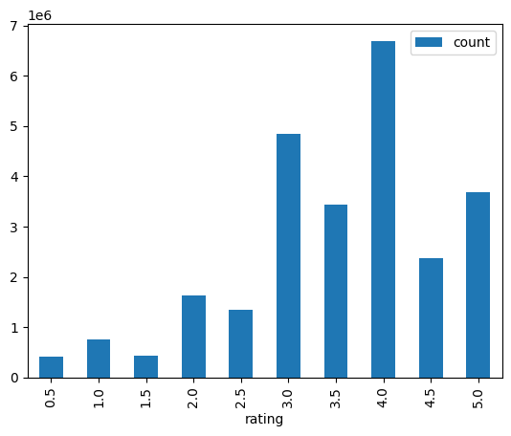
Training data Statistics
Train split: 80%
Number of users: 200948
Number of movies: 80185
Matrix sparsity: 0.159%
Average ratings
Per user: 127.4
Per movie: 319.27
Mean rating: 3.54
Per user: 3.704
Per movie: 3.015
Ratings are skewed

Slide 7
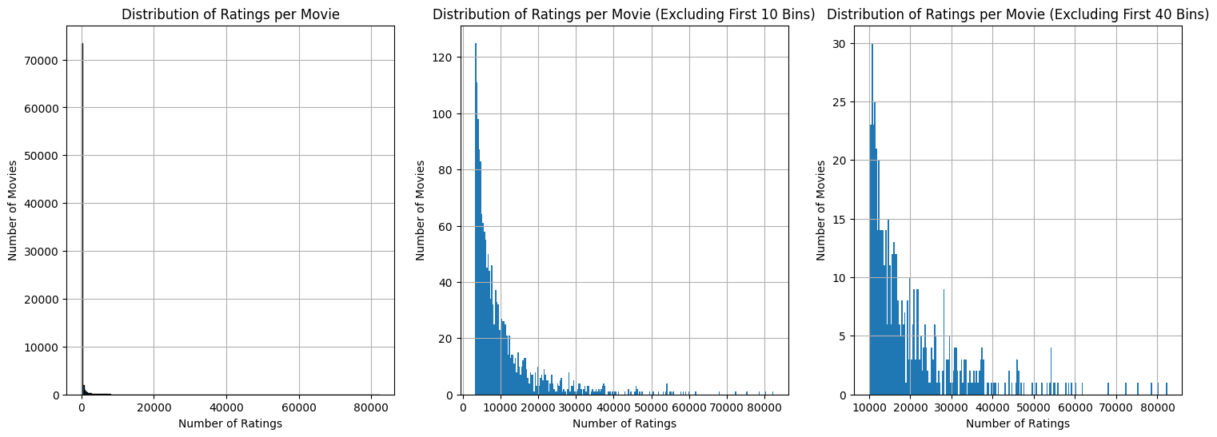
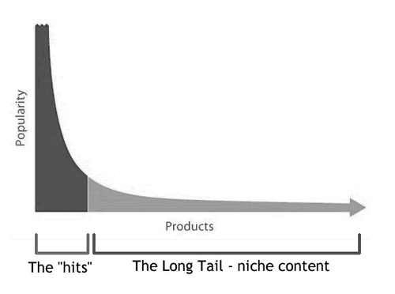
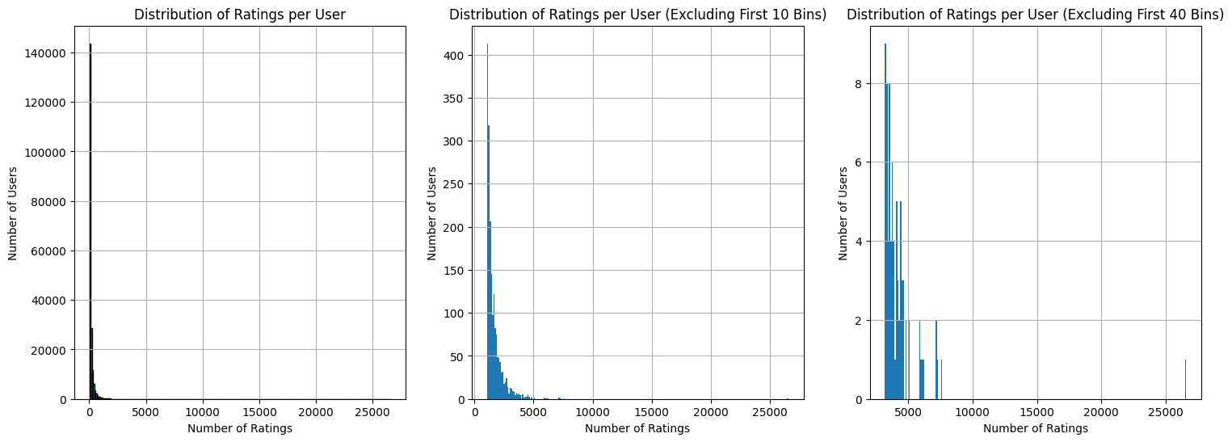
Users and Movies Distribution
Long Tail
Few users rated many movies
Few movies are rated by many users
https://neptune.ai/blog/recommender-systems-metrics

Slide 8


Metrics
Prediction
Ranking
RMSE
MAE
Weighted MAE
Weighted RMSE
Weight
Inverse Document Frequency
$w_{j}=\log{(\frac{m}{m_{j}}) }$
$Precision@k=\frac{Relevant items in 1^{st}k positions}{k}$
$Recall@k=\frac{Relevant items in 1^{st}k positions}{Total relevant items}$
Normalized discounted cumulative gain $NDCG@k=\frac{DCG@k}{IDCG@k}$
$$DCG@k=\sum_{i=1}^{k}{\frac{2^{rel_{i}}−1}{\log_{2}{(i+1)}}}$$
Ideal DCG is the maximum NDCG for the user
https://w3nhao.github.io/2023/03/31/HR-MRR-NDCG-Torchmetric-Implementation/

Slide 9
Algorithms

Slide 10
Baselines
Metric | Average | Median
RMSE | 0.963 | 0.985
MAE | 0.742 | 0.722
Weighted RMSE | 0.967 | 0.988
Weighted MAE | 0.746 | 0.726
Simple group by based on Movie
Took average and median
Excellent performance

Slide 11
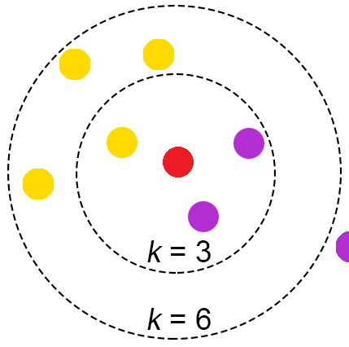

K-NN
200k users and 84k movies
Time complexity for all users:
𝒪$\left(N^{2}M\right)=$𝒪${(10}^{15})=11.5$ days
𝒪$\left(M^{2}N\right)=$𝒪${(10}^{11})=1.68$ min
𝒪$\left(M^{2}\right)$ memory
Impossible for all users in single run
Need to reduce dimension
[글로 읽는 AI 시리즈9] - K-nearest neighbor (KNN기법) : 네이버 블로그

Slide 12
K-NN Dimensional Reduction
k-D trees
Low dimensional and real-valued
LSH
High-d, real-valued or discrete
Inverted Lists
High dimensional, sparse data
𝒪$(M\log_{2}{N})$, where $M≪N$
𝒪(𝑀 log_2⁡𝑁), where 𝑀≪𝑁
Can miss neighbours
𝒪$(N^{′}M^{′})$, $N^{′}≪N, M^{′}≪M$
𝒪(𝑁^′ 𝑀^′), 𝑁^′≪𝑁, 𝑀^′≪𝑀
Exact
𝒪$\left(N^{′}M\right)$ where $N^{′}≪N$
Can miss neighbours
𝒪(𝑁^′ 𝑀) where 𝑁^′≪𝑁
Can miss neighbours
https://www.youtube.com/watch?v=UPAnUE_g5SQ

Slide 13
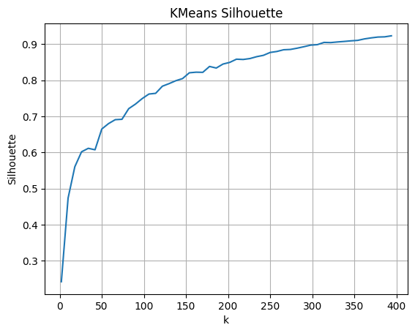
K-means heuristic
Divided movies based on genre
Separated them using k-means
Took average, median and top k movies
Poor performance – Need more tests
Method | RMSE | MAE | W. RMSE | W. MAE
Mean | 1.792 | 1.222 | 1.738 | 1.182
Median | 1.807 | 1.216 | 1.754 | 1.176
Top-10 avg | 1.854 | 1.298 | 1.815 | 1.276

Slide 14
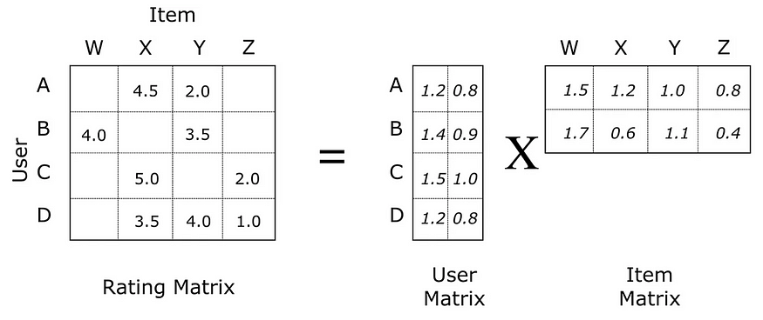

Alternating Least Square method
Latent factor method
Divides $M×N$ matrix into 2 small matrices.
Evaluator: RMSE
Param grid
Rank: [13, 15, 17]
Max Iterations: [19, 20]
Regularizer: [0.18, 0.19]
3 fold cross validation
Best model rank: 13
Recommender System using ALS in Pyspark | by Bruno Borges | Medium

Slide 15
Results
Prediction
Better performance than baseline models
Ranking
Very low values even at k=100
Needle at haystack
Average common movies: 1.549
Genre may help
Ranking Metric | K=10 | K=100
Precision | 5e-7 | 1.55e-6
Recall | 6.25e-7 | 2.75e-6
NDCG | 4.5e-7 | 2.23e-6
RMSE | MAE | W.RMSE | W.MAE
0.85 | 0.662 | 0.851 | 0.664

Slide 16
Future Work
Complete k-NN using Inverted lists
Test more on k-means heuristic
Mix k-NN with k-means
Test more param grid in ALS
Convex Optimization formulation
Concentrate on Ranking version

Slide 17
References
Movielens data - https://grouplens.org/datasets/movielens/
Long tail picture - https://neptune.ai/blog/recommender-systems-metrics
Metrics - https://w3nhao.github.io/2023/03/31/HR-MRR-NDCG-Torchmetric-Implementation/
K-NN picture- https://blog.naver.com/PostView.nhn?blogId=limitsinx&logNo=222146021517
K-NN dimension reduction techniques - https://www.youtube.com/watch?v=UPAnUE_g5SQ
ALS - https://medium.com/@brunoborges_38708/recommender-system-using-als-in-pyspark-10329e1d1ee1
Matrix factorization - https://www.youtube.com/watch?v=ZspR5PZemcs
Textbook – Recommender Systems The Textbook by Charu C. Aggarwal - https://link.springer.com/book/10.1007/978-3-319-29659-3

Slide 18
Thank you!! Any questions??

Slide 19

Understanding the Problem
Prediction version:
Complete $M×N$ matrix for $M$ users and $N$ movies
Ranking version:
Provide top-k items for user
Methods:
Content-based filtering
User past history
Collaborative filtering
User-user comparison
Movie-movie comparison
Latent factor methods
 | 1 | 2 | 3 | 4 | 5
1
2
3
4
5

Slide 20
Data Split – Time based or Random?
Average rating per year
Mean: 3.55
Median: 3.548
Standard deviation: 0.067
Min rating: 3.43
Max rating: 3.75
Independent of time
Random split is fine

Slide 21
K-NN Dimensional Reduction
k-D trees
Low dimensional and real-valued
Inverted lists
High dimensional, sparse data
LSH
High-d, real-valued or discrete
𝒪$(M\log_{2}{N})$, when $M≪N$
𝒪(𝑀 log_2⁡𝑁), when 𝑀≪𝑁
Can miss neighbours
𝒪$(N^{′}M^{′})$, $N^{′}≪N, M^{′}≪M$
𝒪(𝑁^′ 𝑀^′), 𝑁^′≪𝑁, 𝑀^′≪𝑀
Exact
Can miss neighbours
𝒪$\left(N^{′}M\right), N^{′}≪N$
𝒪(𝑁^′ 𝑀), 𝑁^′≪𝑁
Bits in fingerprint

Slide 22

Alternating Least Square method
Latent factor method
Divides $M×N$ matrix into 2 small matrices.
Evaluator: RMSE
Param grid
Rank: [13, 15, 17]
Max Iterations: [19, 20]
Regularizer: [0.18, 0.19]
Best Model rank: 13

Slide 23
Alternating Least Square method
Latent factor method
Divides $M×N$ matrix into 2 small matrices.
Evaluator: RMSE
Param grid
Rank: [13, 15, 17]
Max Iterations: [19, 20]
Regularizer: [0.18, 0.19]
Best Model rank: 13

Slide 24

Alternating Least Square method
Latent factor method
Divides $M×N$ matrix into 2 small matrices.
Evaluator: RMSE
Param grid
Rank: [13, 15, 17]
Max Iterations: [19, 20]
Regularizer: [0.18, 0.19]
3 fold cross validation
Best Model rank: 13

Slide 25
Results
Prediction
Better performance than baseline models
Ranking
Very low values even at k=100
Needle at haystack
RMSE | MAE | W.RMSE | W.MAE
0.85 | 0.662 | 0.851 | 0.664
Ranking Metric | K=10 | K=100
Precision | 5e-7 | 1.55e-6
Recall | 6.25e-7 | 2.75e-6
NDCG | 4.5e-7 | 2.23e-6

